Slide 1

FEATURE SELECTION OF SIGNALS USED IN A SEMICONDUCTOR BASED MANUFACTURING PROCESS

Slide 2
Overview of the project:
Three Phases of the project :
Phase 1 : DATA CLEANING STEPS (and hence feature reduction)
Phase 2 : Feature Selection from the predictive models
Phase 3 : Performance of classification methods on the selected variables

Slide 3
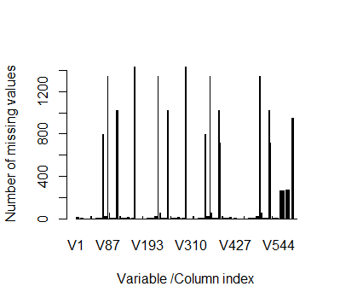
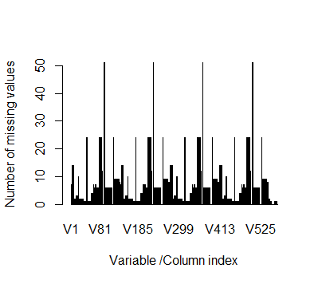
Phase 1 : Data Cleaning Steps (and hence feature reduction):
STEP 1: Added the pass/fail yield column (from the secom label data)
to the secom data.
STEP 2 : Reduced the percentage(%) of missing values column wise
1567 X 592 FIELDS 1567 X 540 FIELDS
DELETED COLUMNS WITH MORE THAN 80 MISSING VALUES (5% OF TOTAL NUMBER OF OBSERVATIONS)

Slide 4
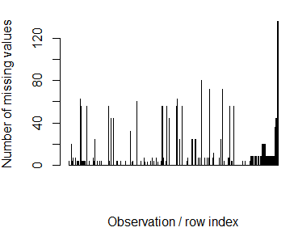
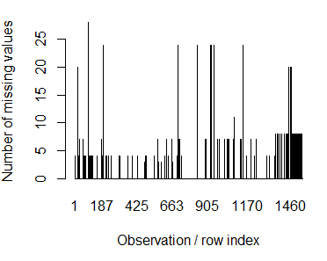

STEP 3 : Reduced the percentage(%) of missing values row wise
STEP 4:
After steps 1,2 and 3, we have 1061 missing fields. 1061 missing values were imputed using missForest function FROM THE missForest package
[missForest is a package used to impute missing values of continuous and/or categorical data. It uses randomForest trained on the observed values to predict the missing values.]
1567 X 540 FIELDS 1521 X 540 FIELDS
DELETED ROW WITH MORE THAN 30 MISSING VALUES (5% OF TOTAL NUMBER OF OBSERVATIONS)

Slide 5
STEP 5:
After imputing the missing values, the columns with same values for all the observations were removed. Dimension of the data set has now changed from 1521 x 540 fields to 1521 x 423 fields.
After all the data cleaning steps were performed, the number of features has reduced from 592 to 423 features, a total of 169 features were removed through data cleaning process.
Identifying the collinear variables and removing them:
All the features that have a correlation more than 0.8 were removed using the “Caret’ package which amounted to reducing the number of features from 423 (After Step 5) to 213 features which were used for the next phase.

Slide 6
STRATEGY AND JUSTIFICATION FOR FEATURE SELECTION METHOD
Phase 2 (Feature Selection from the predictive models):
The response is “pass/fail yield” which is a categorical variable.
Hence classification based methods were considered from all the possible methods. Out of all the classification methods that can be used for variable selection, the tree based methods like classification trees ,pruning, bagging, random forest and boosting were used.
This is because classification trees and pruned trees give out the variables used for classification. And from Bagging, Randomforest and Boosting, we can get the variables that are important using the Variable Importance.
Out of these methods, the method which yield the highest prediction accuracy will be used for variable selection.
After we find the important variables, we apply all possible classification methods to this set of variables and find which method yields the best prediction accuracy.
In the end, we choose the method that gives good prediction accuracy and good interpretability using the selected features.

Slide 7
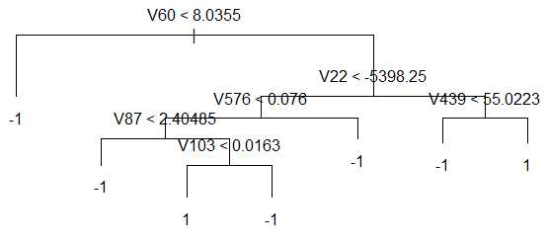
Method 1 : Classification Tree based method
METHODS
Variables used in the tree (important features) :
V60,V131, V23, V103, V490, V83, V52, V468, V68, V284, V492, V22, V576, V87, V419, ,V350, V439, V169, V76
Prediction Accuracy: 86.73%
Sensitivity : 11.32%
Specificity : 92.37%
Method 2 : Pruning
Variables used in the tree (Important features ):
V60,V22,V439,V576,V87,V103
Prediction Accuracy : 92.24%
Sensitivity : 9.4 %
Specificity : 98.44%

Slide 8
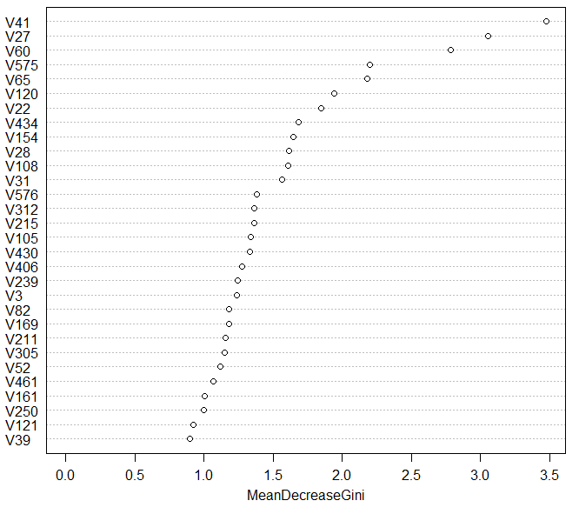
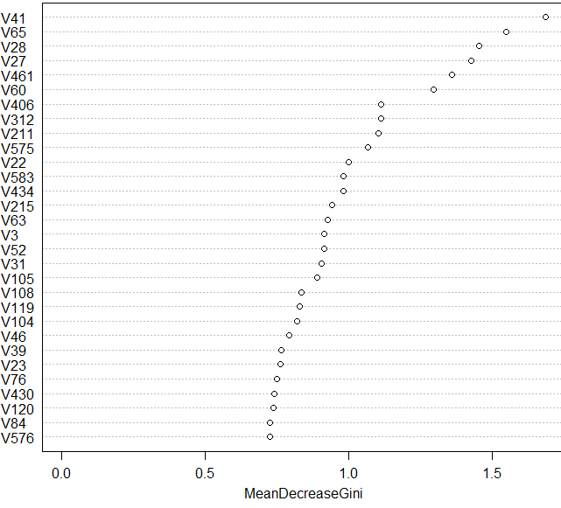
Method 3: Bagging
Variables used in the tree (Important features ):
Prediction Accuracy:92.37%
Sensitivity:7.57%
Specificity:98.7%
Method 4 : Random Forest
Variables used in the tree (Important features ):
Prediction Accuracy: 92.9%
Sensitivity: 0%
Specificity: 99.85%

Slide 9
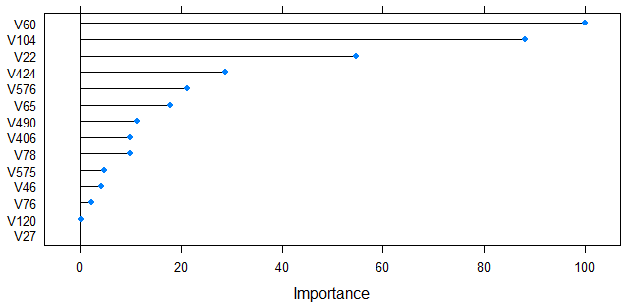
Method 5: Boosting
The variables selected through boosting are as follows
V60 +V406 +V22 +V120+V65 +V576 +V76 +
V104 + V46 +V27 +V424 +V78 +V575 +V490
Note: We have selected variables with relative
influence more than 1. This can be subject to change.
Accuracy : 93.03 %
The variables selected by boosting will be used for
model construction since the accuracy obtained by
boosting is the highest.
The Rank Importance of all the variables:
This plot was generated using the ‘Caret’ package for
the selected variables in the boosting model

Slide 10
Phase 3: (Performance of classification methods on the selected variables ):
Model | Accuracy | Sensitivity | Specificity
Logistic | 92.9 | 3.77 | 99.57
Pruning | 91.85 | 7.5 | 98.16
Bagging | 91.9 | 1.8 | 98.72
Random Forest | 92.77 | 1.8 | 99.57
Boosting (threshold=0.5) | 93.03 | 0 | 100
Boosting (threshold=0.06) | 68.06 | 69.81 | 67.98
Boosting (threshold=0.07) | 76.87 | 58.5 | 78.25
Boosting (threshold=0.08) | 81.21 | 37.7 | 84.46
SVM ( Linear Kernel) | 93.03 | 0 | 100
SVM ( Polynomial Kernel) | 86.7 | 16.9 | 92.37
SVM (Radial Kernel) | 83.4 | 20.7 | 87.5
KNN (with k=13 as best) | 93.03 | 0 | 100

Slide 11
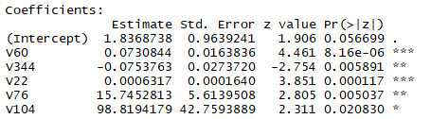
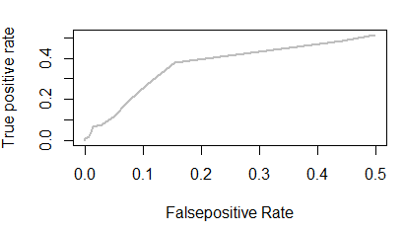
Inferences
It can be seen that the Support Vector Machines model with Linear Kernel,Boosting and KNN (all with 93.03% prediction accuracy) are the best. But those models do not offer a good interpretability. Hence, a logistic model from the previous model has been further refined to find that the following model (gave a comparable accuracy of 92.9%) and the set of variables(reduced) can be used.
Also it can be seen that the sensitivity of all models are predominantly
less than 5%. Hence in the boosting model, the threshold can
be changed to achieve better sensitivity at the cost of specificity
and the overall accuracy. This decision can be made based on the cost and
the impacts associated with failing a good product and passing a faulty product.
Variables for this logistic model:V60,V344,V22,V76,V104
ROC Curve

Slide 12
CONCLUSION:
If prediction is the only criteria:
Method: KNN/boosting/ Support Vector Classifier
Important variables :
[ V60 ,V406 ,V22 ,V120,V65,V576,V76,V104,V46,V27,V424,V78,V575,V490 ]
If interpretability is given more importance and also a good prediction is needed, then :
Method: Logistic Regression
Important Variables:
[ V60,V65,V26,V329,V125,V27,V342 ]
Insights gained from the project:
It was clear from the project that there is a lot of unrelated features collected in an industry for
which the data collection costs are and the computational speeds to analyze the data is high.
Also the data handling becomes complex.
Data cleaning must be performed in a sensible way that ensures that large amount of data which
might be useful in the model are not lost.
A vital few variables are more important than the trivial many.

